Slide 1
UI/UX Design
Lesson 2: UI/UX Design II
Presented by Krystal Educational Platform

Slide 2
Lesson Outline
Learn about what is Penpot
Understand the interface basic function of Penpot
Learn about the Penpot toolbar function
Try to follow the example to make a simple UI design

Slide 3
Contents
2.1
How To Start To Use Penpot
2.5
Penpot Layer Basics (II)
2.3
Penpot Workspace Basics
2.2
Penpot Interface Basic Function
2.4
Penpot Layer Basics (I)
2.6
Penpot Logo Practice

Slide 4
How To Start To Use Penpot
2.1

Slide 5
2.1 How To Start To Use Penpot
How many UI/UX Design tools do you know about it?

Slide 6
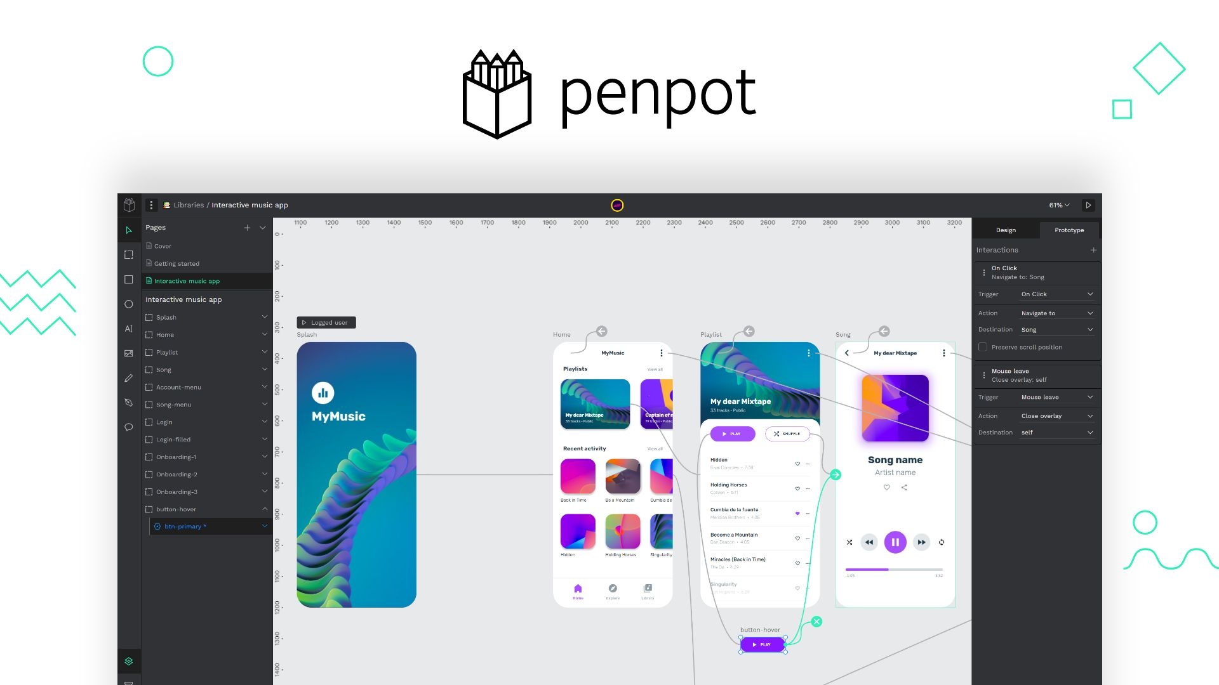
2.1 How To Start To Use Penpot
Penpot is the first Open Source design and prototyping platform meant for cross-domain teams. Non dependent on operating systems, Penpot is web based and works with open web standards (SVG). For all and empowered by the community.
Screenshot © https://help.penpot.app/user-guide/

Slide 7
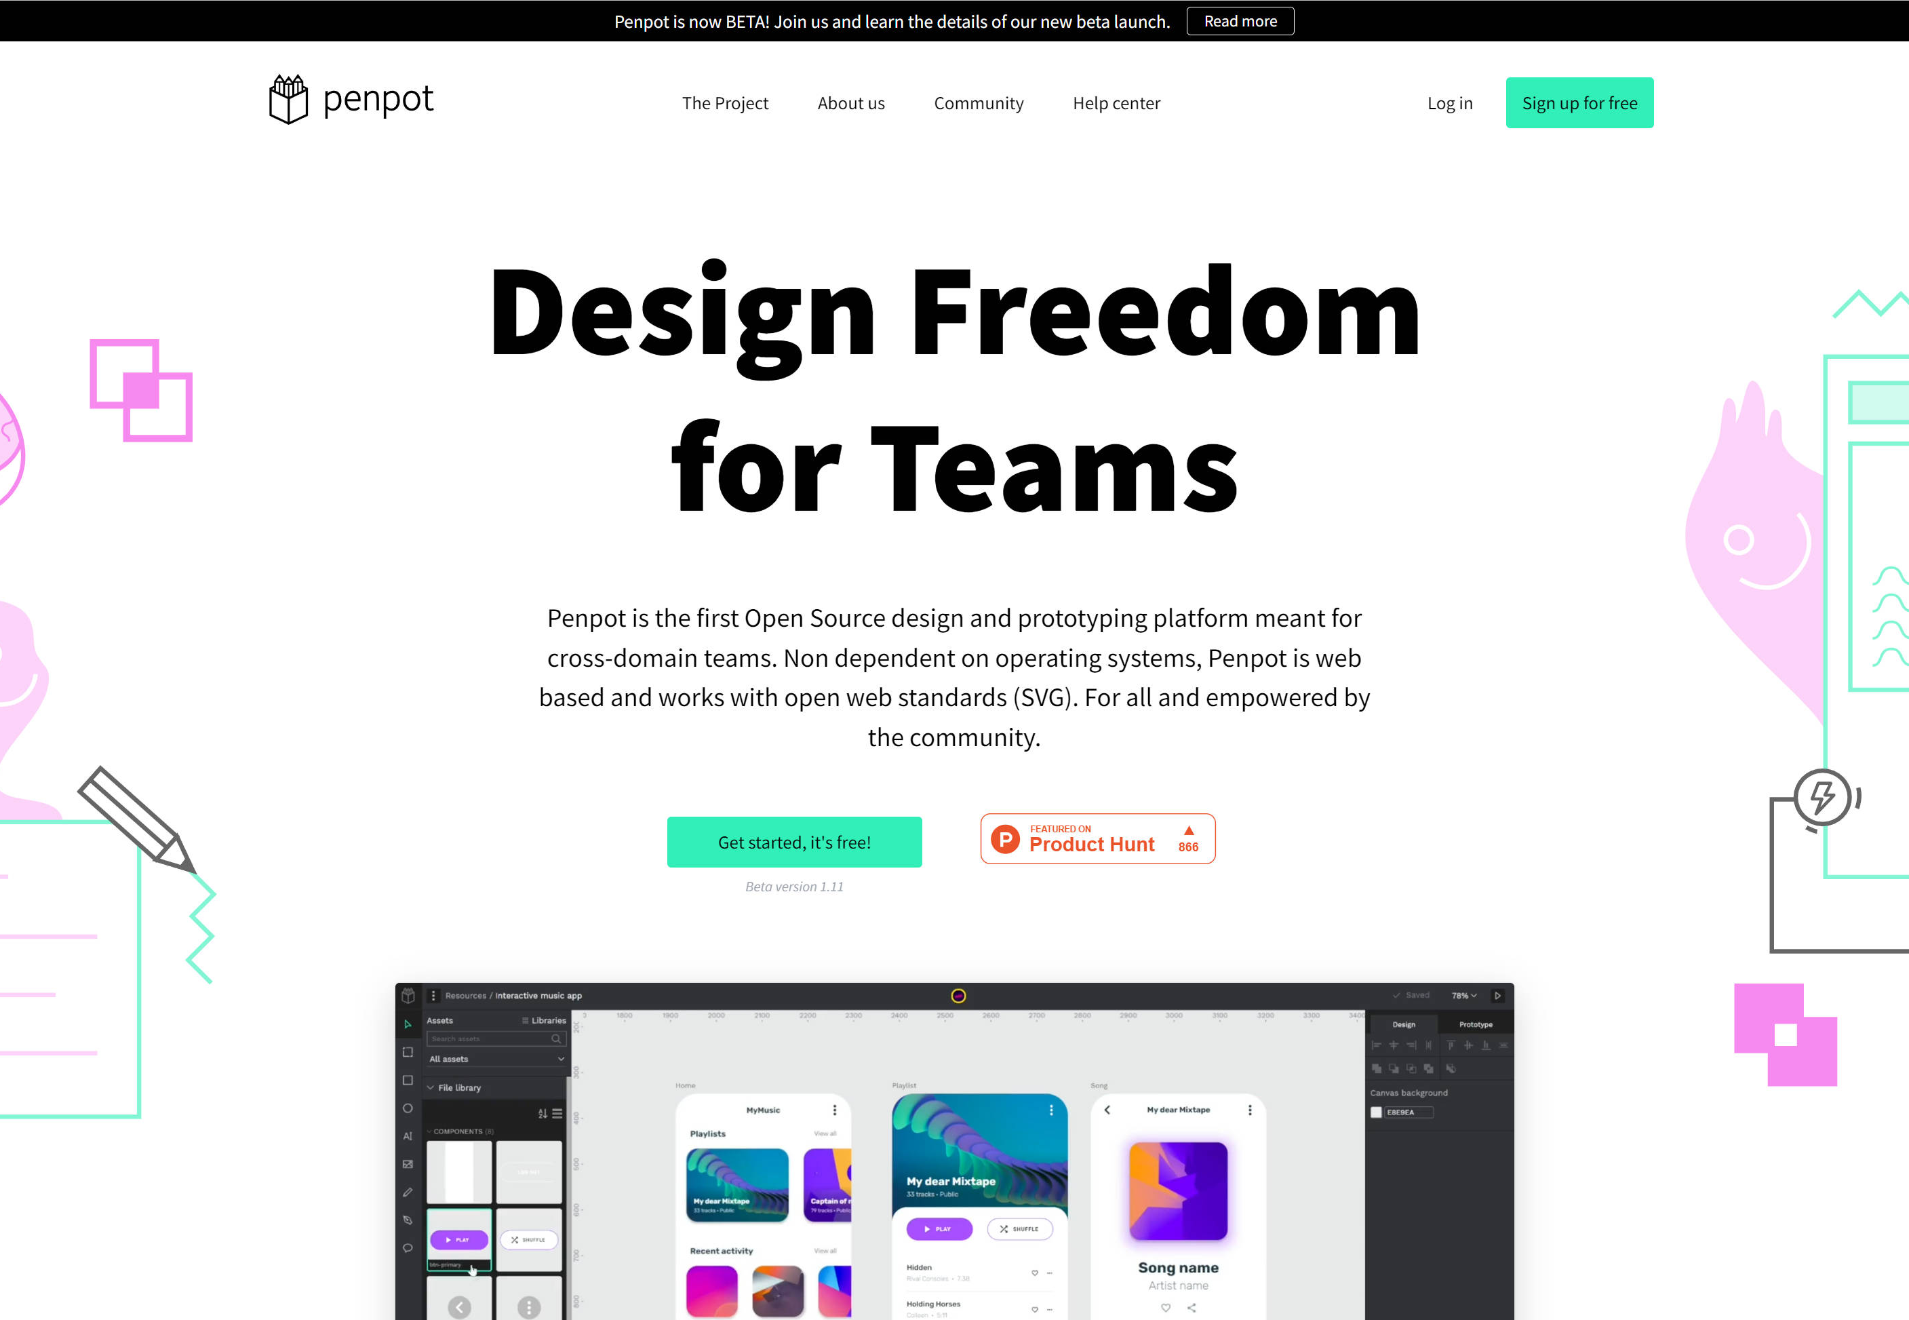
2.1 How To Start To Use Penpot
Step1: Search Penpot in any browser, and click the ‘Get Started, it’s Free!’ Button.
Screenshot © https://help.penpot.app/user-guide/

Slide 8
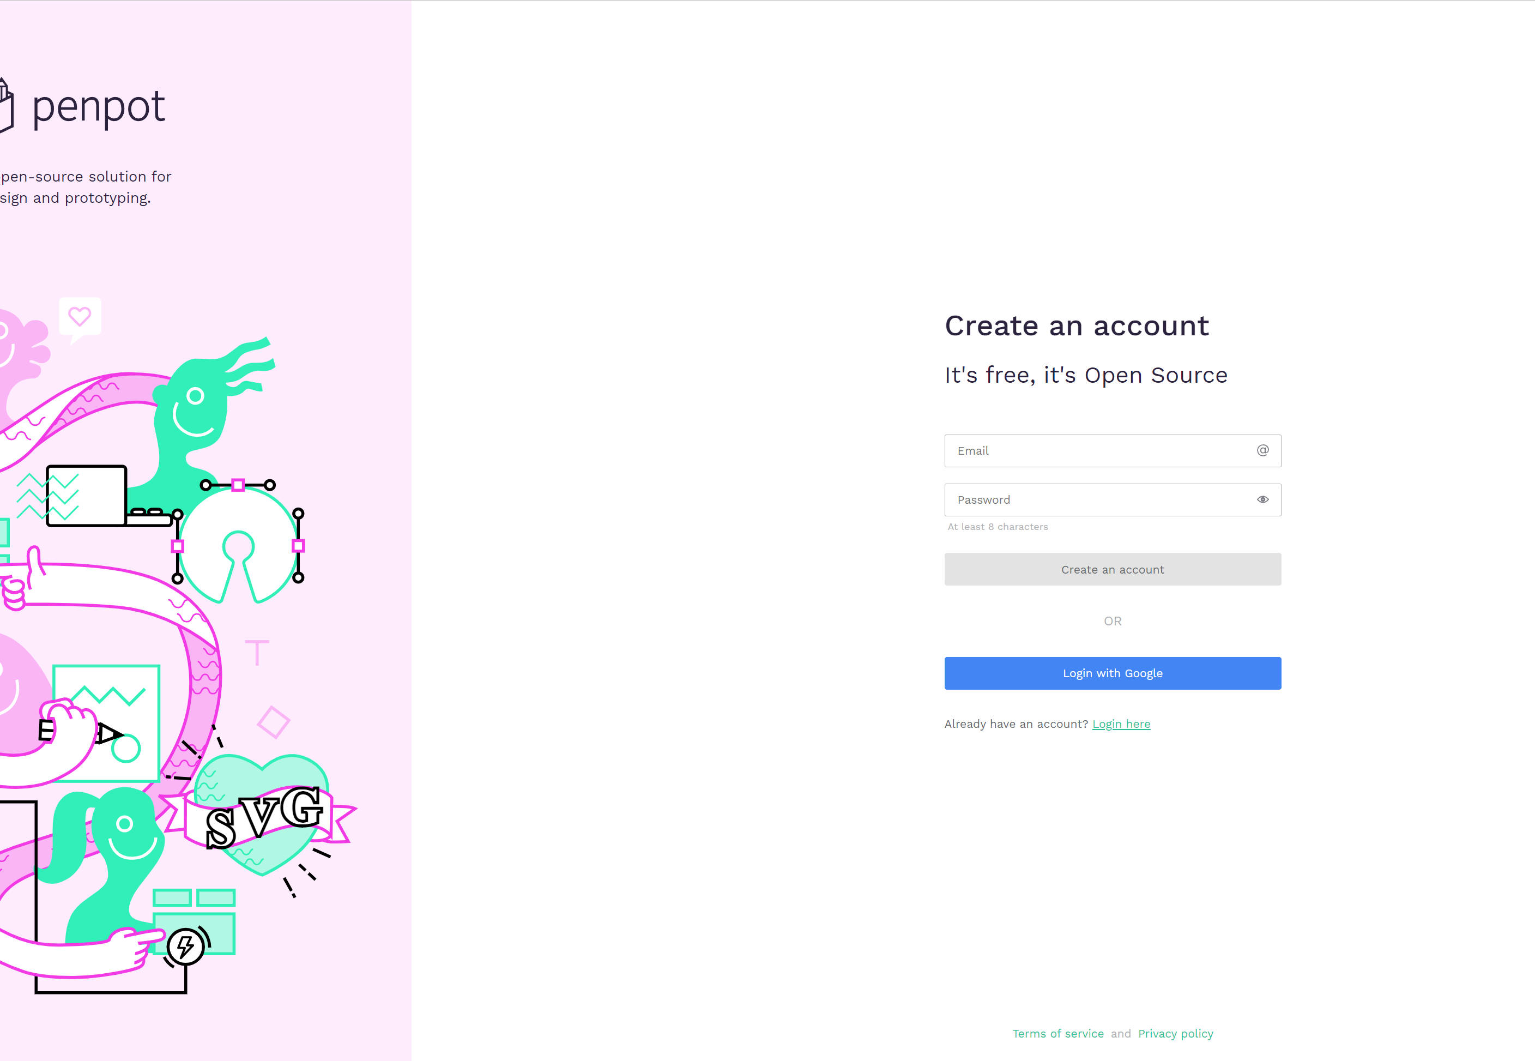
2.1 How To Start To Use Penpot
Step2: and sign up for an account on the website. Basically, you can log in directly with your Google account.
Screenshot © https://help.penpot.app/user-guide/

Slide 9
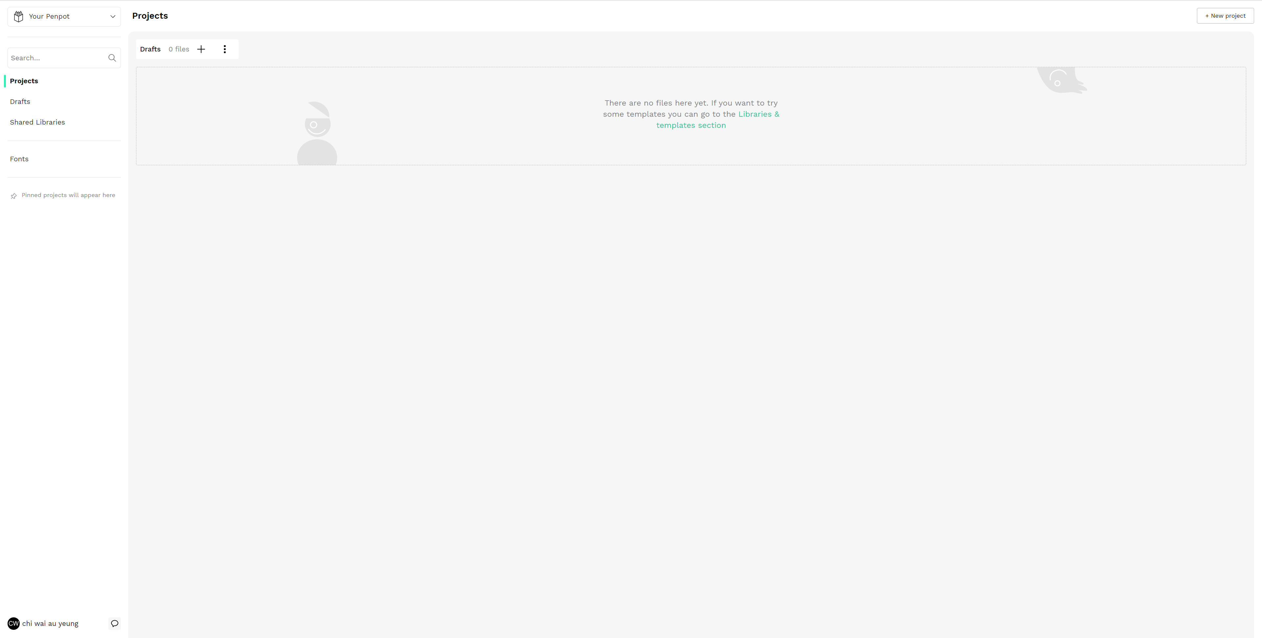
2.1 How To Start To Use Penpot
Step3: After logging in, this dashboard will appear. This is the basic dashboard of Penpot.
Screenshot © https://help.penpot.app/user-guide/

Slide 10
Penpot Interface Basic Function
2.2

Slide 11
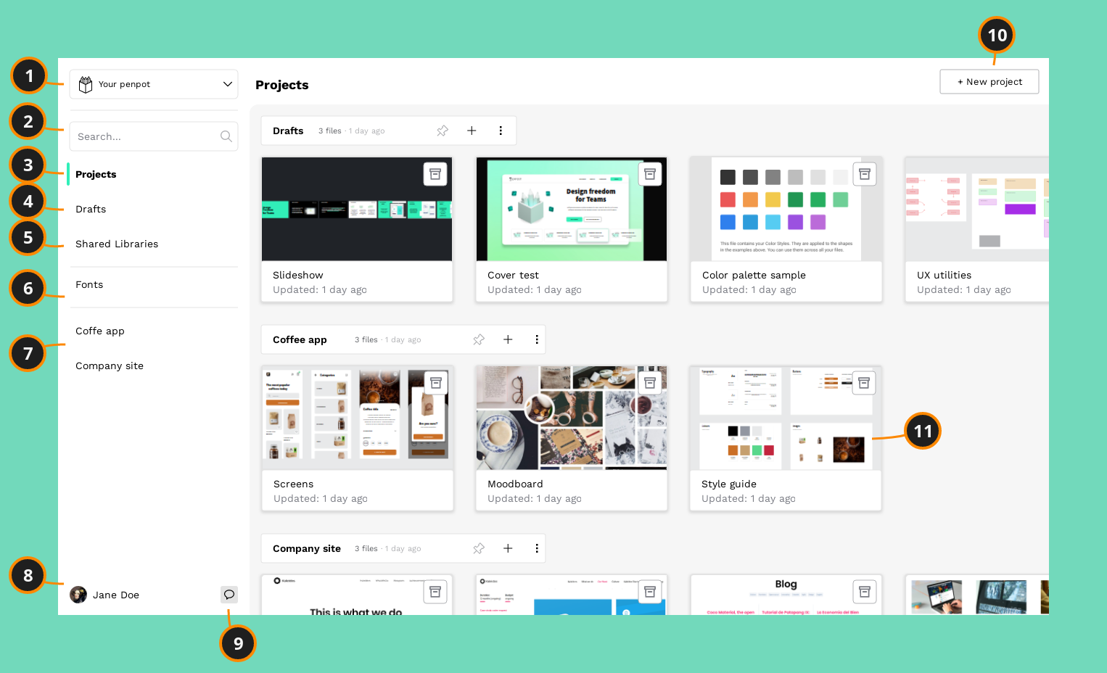
2.2 Penpot Interface Basic Function
Dashboard
The Dashboard is the place where you will be able to organize your files, libraries, projects and teams.
Screenshot © https://help.penpot.app/user-guide/

Slide 12
2.2 Penpot Interface Basic Function
Dashboard
1) Team 7) Pinned projects
2) Search files 8) User area
3) Projects 9) Comments notification
4) Drafts 10) Create project
5) Shared Libraries 11) Filecard
6) Custom fonts
Screenshot © https://help.penpot.app/user-guide/

Slide 13
2.2 Penpot Interface Basic Function
Dashboard
1) Teams: A team allows you to collaborate with other penpot users. Team members are allowed to work with any project or file within the team depending on their permissions. Members with admin permissions can also invite other members. Create or join as many teams as you need with different groups of people.
2) Search: If you are looking for a specific file just type its title at the search box.
3) Projects: A project allows you to group design files. It works pretty much like a folder in a file system. You can create as many projects as you need. If you are going to work with more people in a project, you should create it inside a team.
Screenshot © https://help.penpot.app/user-guide/

Slide 14
2.2 Penpot Interface Basic Function
Dashboard
4) Drafts: The drafts section is where you can find the design files that are not inside any project.
5) Shared Libraries: In this section you will find all the design files that have been added as shared libraries. That way you will be able to better control the files that are sharing their assets.
6) Custom fonts: If you have purchased or personal fonts that are not included in the catalog provided by Penpot, you can upload them from your computer and use them across the files of a team.
Screenshot © https://help.penpot.app/user-guide/

Slide 15
2.2 Penpot Interface Basic Function
Dashboard
7) Pinned projects: If you want to keep some projects handy (for instance because you’re currently working on them) you can pin them to make them show at the sidebar.
8) User area: This must be you! Change your profile, password or change the language from the settings. You can also find here a way to leave us feedback. We’d love to read your thoughts :)
9) Comments notifications: Here you will be able to see if you have unread comments inside the files of the team.
Screenshot © https://help.penpot.app/user-guide/

Slide 16
4.2 Penpot Interface Basic Function
Dashboard
10) Create project: Create as many projects as you need to organize your designs.
11) File card: Basic information about a file at plain sight. How it looks like, last update or if it’s added as a Shared Library. You can rename or delete a file. A lot of more options coming soon.
Screenshot © https://help.penpot.app/user-guide/

Slide 17
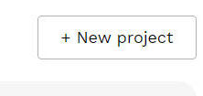
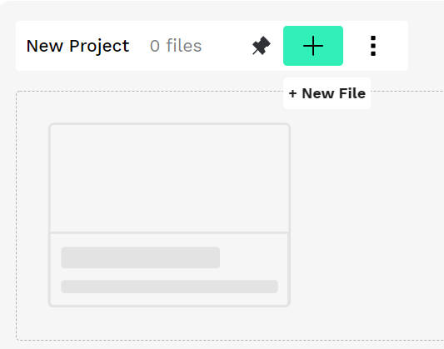
2.2 Penpot Interface Basic Function
Click the New project button to create a new project
You will see the New Project title has 0 files, click the button to create a new file.
Screenshot © https://help.penpot.app/user-guide/

Slide 18
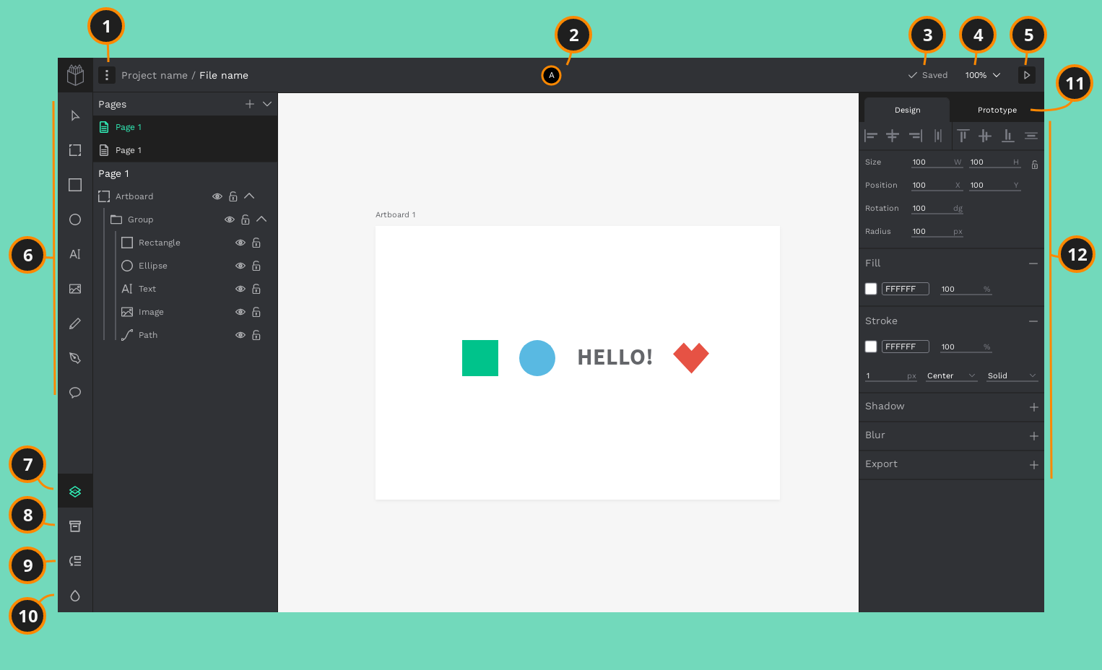
2.2 Penpot Interface Basic Function
After you click the button, you will see this Workspace.
The Workspace is where you create your designs. You have an infinite canvas where you can work directly but you also can create and work inside artboards that will help you to create pages and exportation units.
Screenshot © https://help.penpot.app/user-guide/

Slide 19
2.2 Penpot Interface Basic Function
Workspace
1) Main menu 7) Layers panel
2) Users 8) Assets panel
3) File status 9) History panel
4) Zoom 10) Palettes panel
5) View mode 11) Prototype mode
6) Toolbar 12) Object properties
Screenshot © https://help.penpot.app/user-guide/

Slide 20
2.2 Penpot Interface Basic Function
Workspace
1) Main menu: At the file main menu you are able to tweak your workspace configuration. Manage visibility for grids, rules, panels. Enable or disable snapping, dynamic alignment. Add or remove the file as Shared Library. There’s also a link to the feedback options.
2) Users: You can see how many users are working in the file at the same time.
3) File status: Information about the file saving state. Know if last changes are saved or if there is a problem.
Screenshot © https://help.penpot.app/user-guide/

Slide 21
2.2 Penpot Interface Basic Function
Workspace
4) Zoom: Zoom options and shortcuts information.
5) View mode: The view mode button launches a presentation with the artboards. See more about what you can do at the view mode.
Screenshot © https://help.penpot.app/user-guide/

Slide 22
2.2 Penpot Interface Basic Function
Workspace
6) Toolbar: The toolbar is the place where you will find the tools to quick and easily create the different types of objects: Artboard, rectangle, ellipse, text, graphic, path, free drawing and comments.
7) Layers panel: The Layers panel allows you to see and manage the layers and pages of a file. A file can have as many pages as you need. Each page has its own viewport (the almost infinite area where you actually create your designs) with its own layers. You can create, delete or reorder your pages at your needs.
Screenshot © https://help.penpot.app/user-guide/

Slide 23
2.2 Penpot Interface Basic Function
Workspace
8) Assets panel: Each file has a default library (File Library) where that allows to store elements and styles that are likely to be reused. That includes components, graphics, colors and typographies. To add an asset to a library just click the “+” button at the header of each asset group.
9) History panel: The history panel keeps track of the latest changes on an opened file. You can do undo/redo to walk the changes and expand each one of them to get detailed information.
10) Palettes panel: The colors palette allows you to always have a color library at plain sight. Use the menu to easily switch between libraries.
Screenshot © https://help.penpot.app/user-guide/

Slide 24
2.2 Penpot Interface Basic Function
Workspace
11) Prototype mode: Penpot allows you to prototype interactions connecting artboards. Once selected the prototype mode at the right sidebar, select an element to drag a connection to another artboard. You’ll be able to see the interactive prototype in action in the view mode (access by clicking the play button at the top right). More about prototyping
12) Object properties: At the Design panel you can find and edit the properties of a selected shape. The list of properties shown varies depending on the type of element. There are some common properties always set (like size and position) and others not set but available to be added (stroke, shadow, blur...).
Screenshot © https://help.penpot.app/user-guide/

Slide 25
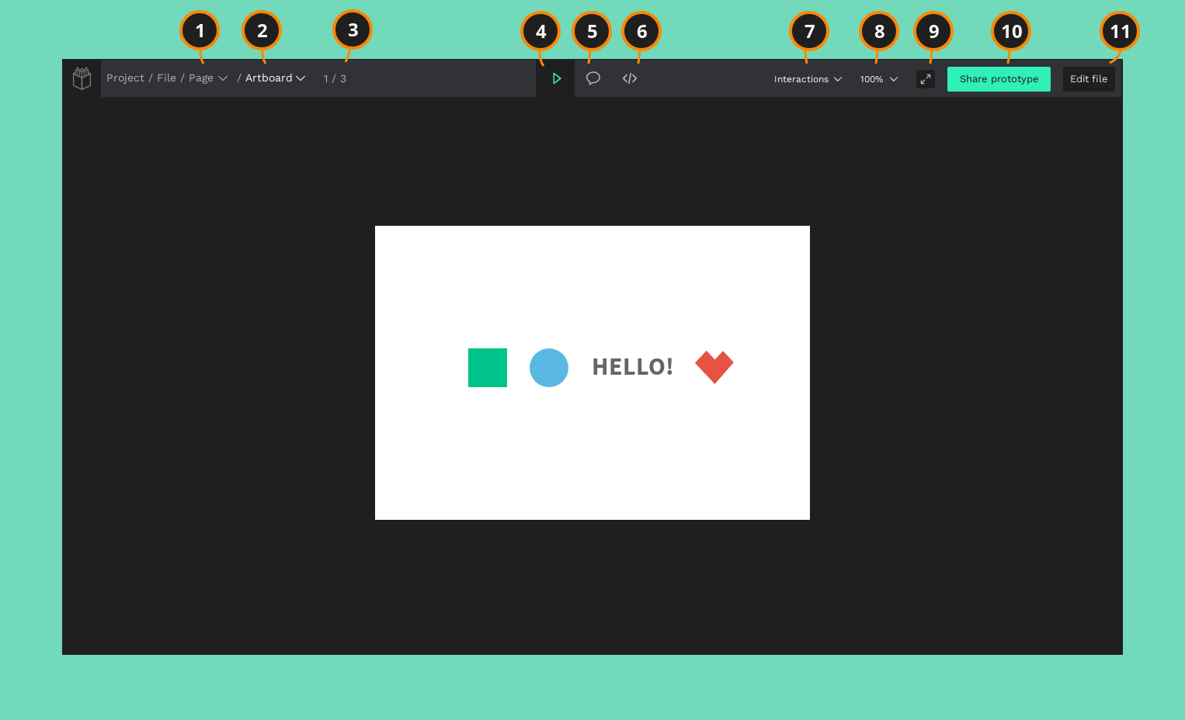
2.2 Penpot Interface Basic Function
View mode
Click the view mode button, to get into this interface.
Launch the view mode to present and share your designs or play with the interactions set at the workspace. You also have a code mode where you can get objects specifications and code snippets.
Screenshot © https://help.penpot.app/user-guide/

Slide 26
2.2 Penpot Interface Basic Function
View mode
1) Pages selector 7) Interactions settings
2) Artboards selector 8) Zoom options
3) Artboards counter 9) Fullscreen
4) Play mode 10) Share prototype options
5) Comments mode 11) File edition
6) Code mode
Screenshot © https://help.penpot.app/user-guide/

Slide 27
2.2 Penpot Interface Basic Function
View mode
1) Pages selector: Navigate through the pages of a file. If is a shareable link this can be configured.
2) Artboards selector: Frames selector displays a list of the artboards with thumbnails that provide a graphic overview of the file.
3) Artboards counter: Artboards count and current position.
Screenshot © https://help.penpot.app/user-guide/

Slide 28
2.2 Penpot Interface Basic Function
View mode
4) Play mode: Default presentation mode where you can also play with interactions.
5) Comments mode: Comments mode shows comments inside artboards and allows users to reply or add new ones.
6) Code mode: At code mode you can get design specifications such as object properties, measurements and distances. You can also get code snippets for styles (currently CSS only but more coming) and SVG markup.
Screenshot © https://help.penpot.app/user-guide/

Slide 29
2.2 Penpot Interface Basic Function
View mode
7) Interactions settings: Select whether to highlight interactions active areas on click, all the time or not at all. More about interaction settings
8) Zoom: Zoom options and info about their shortcuts.
9) Fullscreen mode: Activate or deactivate browser fullscreen mode.
Screenshot © https://help.penpot.app/user-guide/

Slide 30
2.2 Penpot Interface Basic Function
View mode
10) Share link: Create shareable links of the view mode to send it so developers, other designers, or stakeholders can view the designs and access the code specifications regardless of being at your team or even logged at Penpot.
11) Edit file: Opens file edition at the design workspace.
Screenshot © https://help.penpot.app/user-guide/

Slide 31
Penpot Workspace Basics
2.3

Slide 32
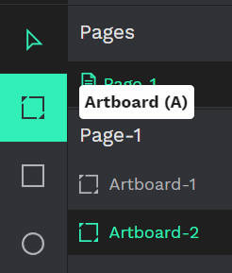

2.3 Penpot Workspace Basics
Use the Artboard button on the toolbar, Pull out an artboard of the right size.
Screenshot © https://help.penpot.app/user-guide/

Slide 33
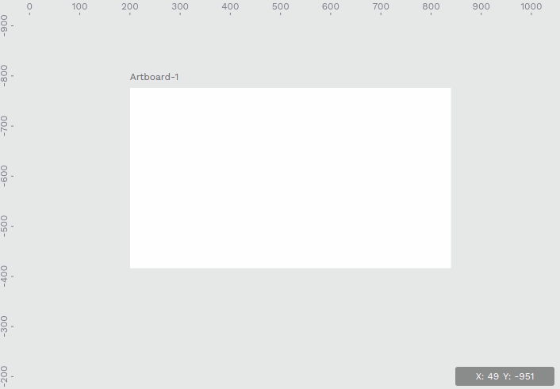
2.3 Penpot Workspace Basics
Navigate the viewport
When creating more than one artboard, we can Press the space bar or middle mouse button while moving your mouse to navigate the viewport. If using a trackpad we can do two-finger scrolling.
Screenshot © https://help.penpot.app/user-guide/

Slide 34
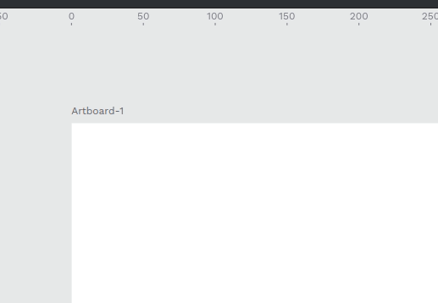
2.3 Penpot Workspace Basics
Rulers
Penpot has rulers that measure in pixels. Soon there will be guides that can be dragged from the rulers. Use CTRL + roller wheel in the middle of the mouse to zoom in.
Picture © https://help.penpot.app/user-guide/

Slide 35
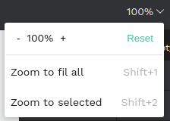
2.3 Penpot Workspace Basics
Zoom
To zoom in and out hold Ctrl (or ⌘ if using macOS) and use the scroll wheel on your mouse. You also have a bunch of useful shortcuts for the most common zoom levels that you can find at the zoom menu in the navigation bar.
Screenshot © https://help.penpot.app/user-guide/

Slide 36


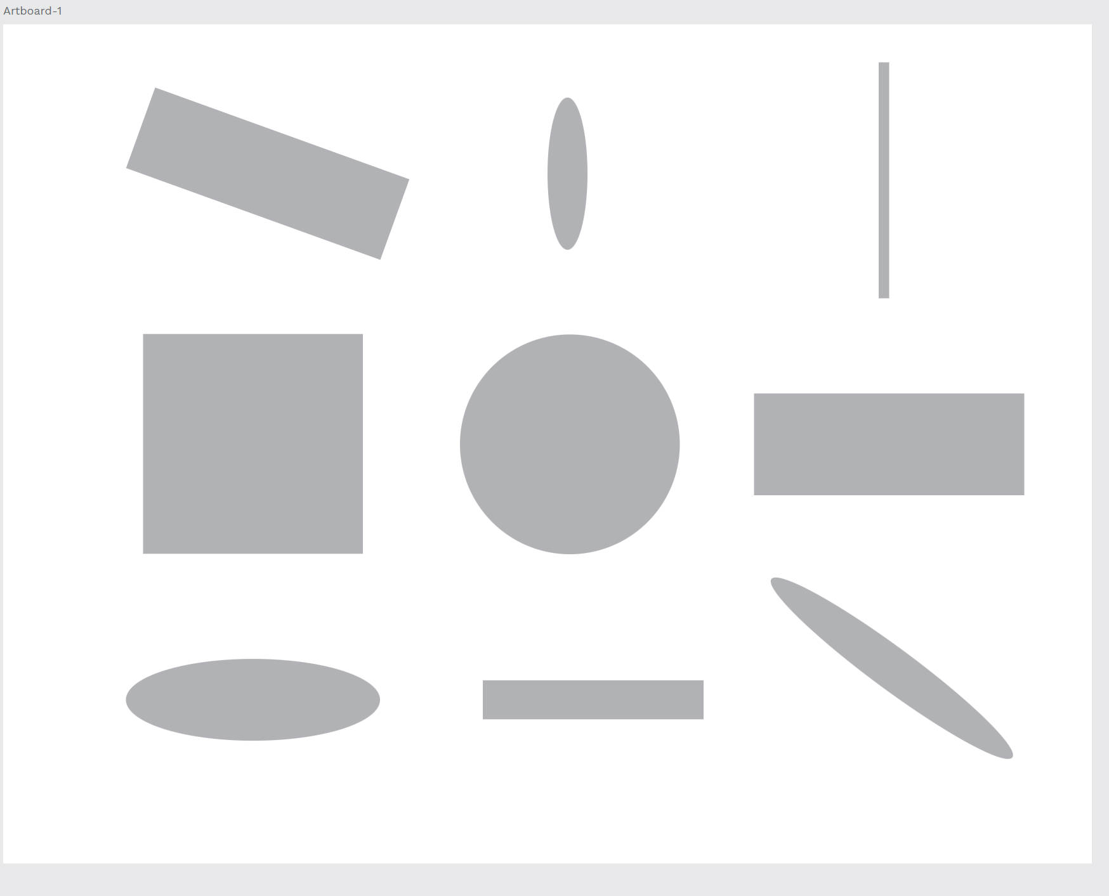
2.3 Penpot Workspace Basics
Use the Rectangle and Ellipse button on the toolbar, Create some rectangles and ellipses on the artboard. Then try to rotate and scale the objects you create.
Screenshot © https://help.penpot.app/user-guide/

Slide 37
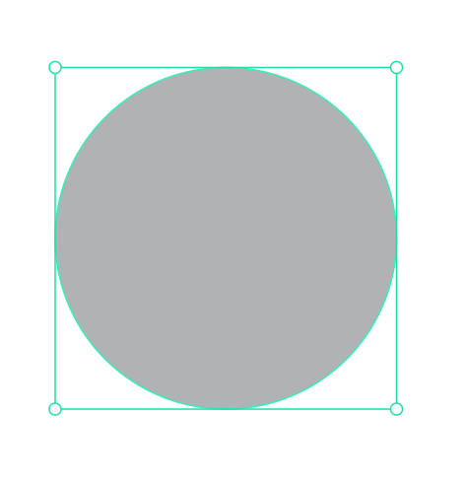
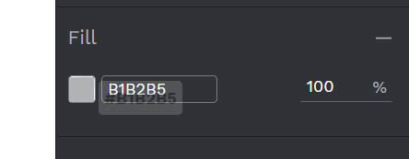
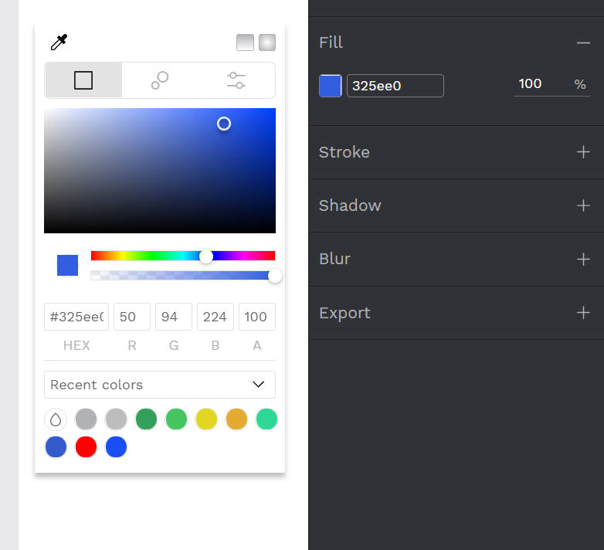
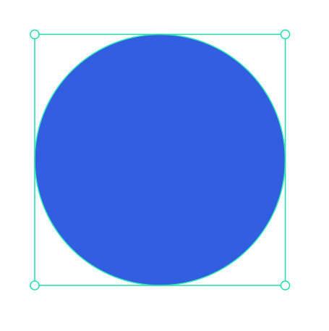
2.3 Penpot Workspace Basics
Select the objects you created, Find the Fill column on the object properties, click the grey square, after clicking the grey square will pop up color properties, then select the color for the objects you created.
Hold Shift/⇧ while creating an ellipse or a rectangle to maintain equal width and height.
Screenshot © https://help.penpot.app/user-guide/

Slide 38
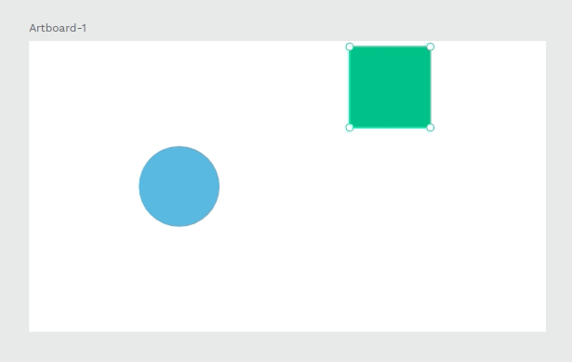
2.3 Penpot Workspace Basics
Dynamic alignment
While moving objects at the viewport Penpot will show alignment guides for the edges and the center of the layers at sight. Dynamic alignment also snaps the object that is being moved to those guides to help you align to the center of the edges of other objects.
Picture © https://help.penpot.app/user-guide/

Slide 39
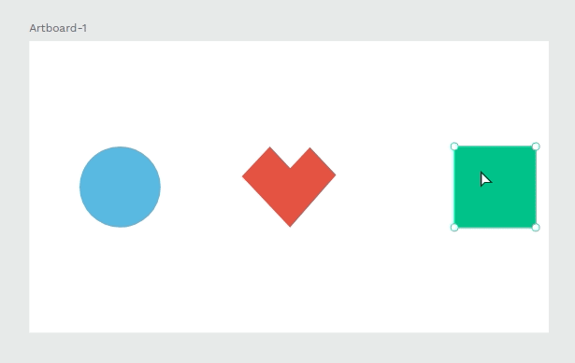
2.3 Penpot Workspace Basics
Dynamic alignment
If there are more than two objects nearby and you drag one of them Penpot will show their distance to help you distribute them equally.
Picture © https://help.penpot.app/user-guide/

Slide 40
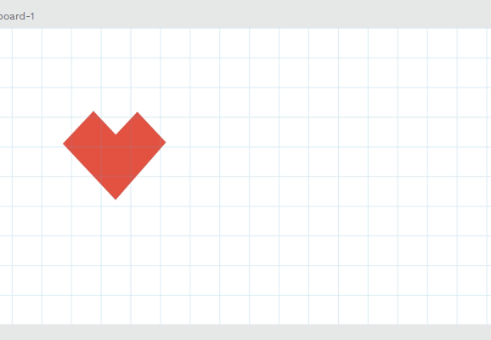
2.3 Penpot Workspace Basics
Snap to grid
Objects automatically snap to the nearest point of a visible grid. This option can be disabled anytime from the main menu.
Picture © https://help.penpot.app/user-guide/

Slide 41
Penpot Layer Basics (I)
2.4

Slide 42
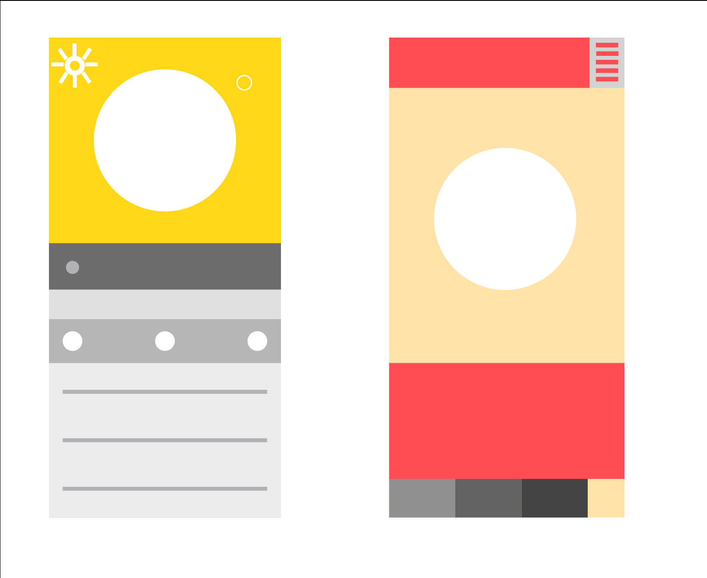
2.4 Penpot Layer Basics (I)
What is a layer and what does it do?

Slide 43
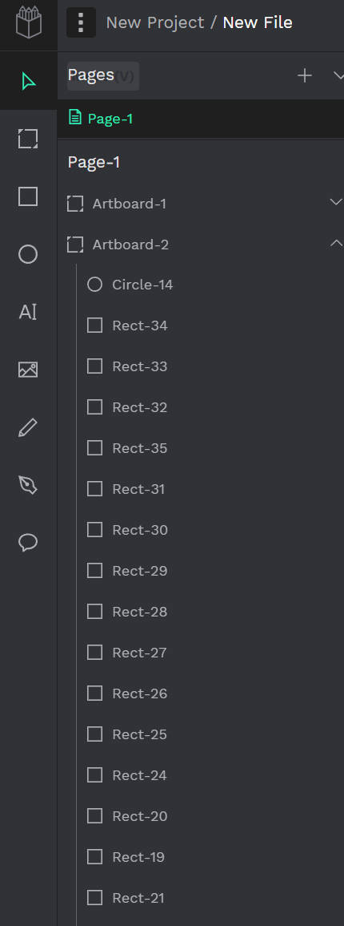
2.4 Penpot Layer Basics (I)
Every object you create in Penpot’s workspace is a layer. Rectangles, ellipses, artboards or text boxes are layers that you can use to build your design.
Picture © https://design.penpot.app/

Slide 44
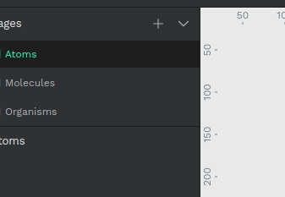
2.4 Penpot Layer Basics (I)
Pages
Pages allow you to organize layers into separate sections inside a file and are shown in separate tabs. Subdividing a file into pages gives you the ability to split your file into logically different sections so that you can organize your work. For instance, you can use pages to separate stages of the design process but keep them in the same document. Different screen sizes, features, or atomic design categories are other common ways to use pages.
You can add, remove or rename pages to suit your needs.
Picture © https://design.penpot.app/

Slide 45
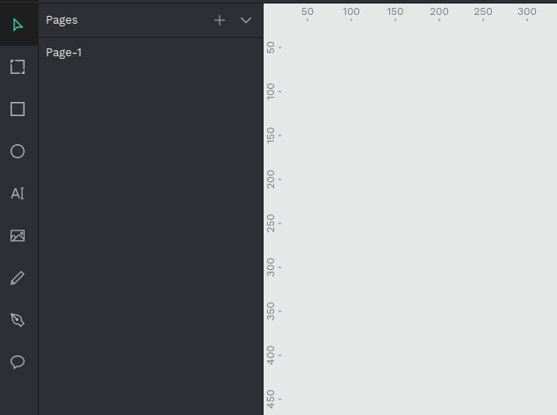
2.4 Penpot Layer Basics (I)
Creating layers
To create a layer you have to select the type of layer by clicking the selected tool (artboard, rectangle, ellipse, text, image, path or curve) at the toolbar. Then you usually have to click and drag your mouse on the viewport.
Picture © https://design.penpot.app/

Slide 46
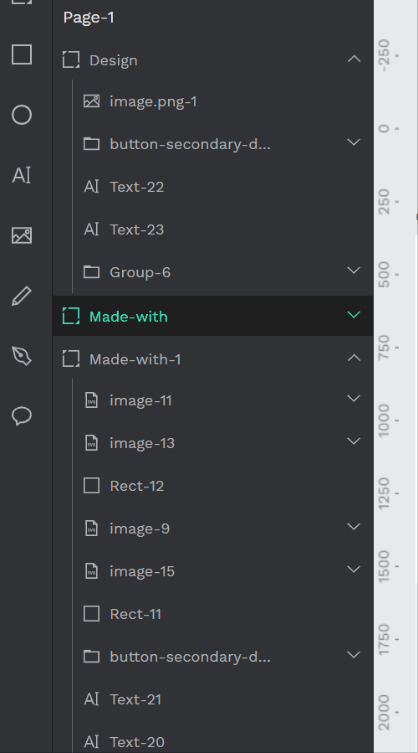
2.4 Penpot Layer Basics (I)
Collapsing groups and artboards
Groups and artboards can have their contents expanded and collapsed. Click on the arrow at the right side to toggle the visibility of their contents
Picture © https://design.penpot.app/

Slide 47
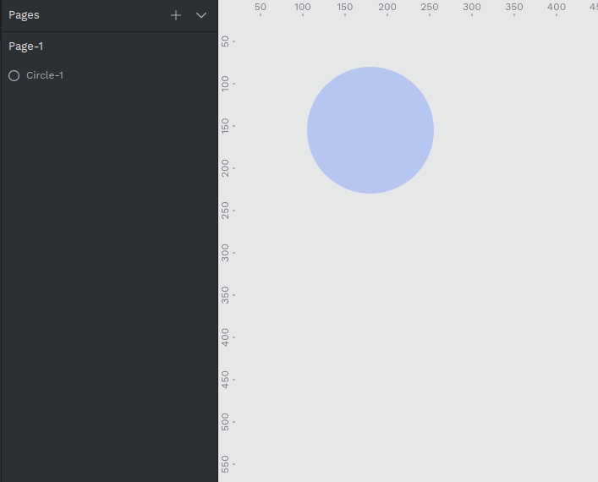
2.4 Penpot Layer Basics (I)
Duplicating layers
There are several ways to duplicate a layer:
You can press Ctrl/⌘ + D to duplicate a layer right over a selected layer.
If you press right click over a selected layer at the viewport or at the layers panel you can use the option at the layer menu.
You can also select a layer and drag while pressing Alt/⌥ so you can simultaneously duplicate and drag the new layer.
Picture © https://design.penpot.app/

Slide 48
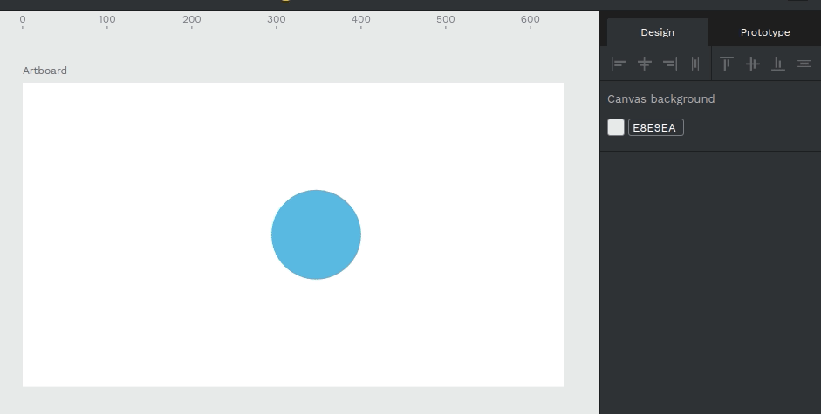
2.4 Penpot Layer Basics (I)
Moving layers
To move one or more layers on the viewport you have to select them first and then click and drag the selection where you want to place them. You can also use the design panel to set a precise position relative to the viewport or the artboard.
Picture © https://help.penpot.app/user-guide/

Slide 49
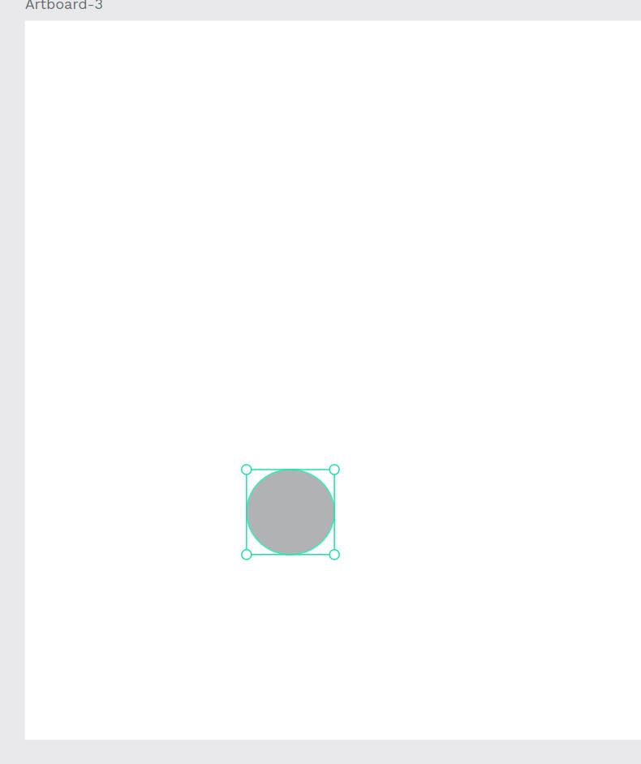
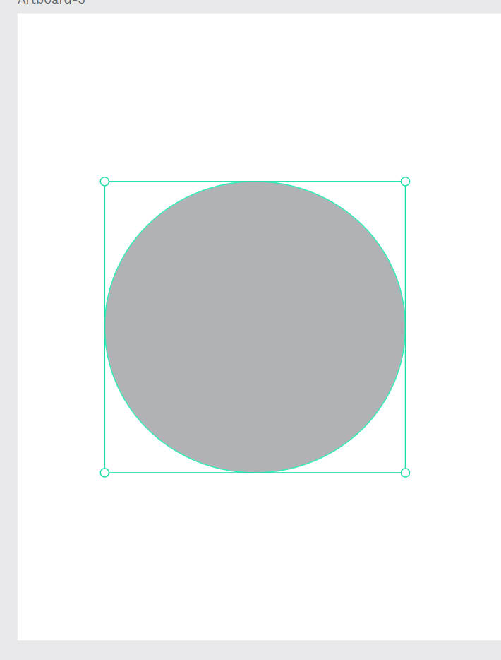
2.4 Penpot Layer Basics (I)
Resizing layers
To resize a selected layer you can use the handles at the edges of the selection box. Make sure the cursor is in resizing mode. If you hold Shift/⇧ while resizing the object will preserve its current proportions. You can also use the design panel where you can link width and height.
Picture © https://help.penpot.app/user-guide/

Slide 50
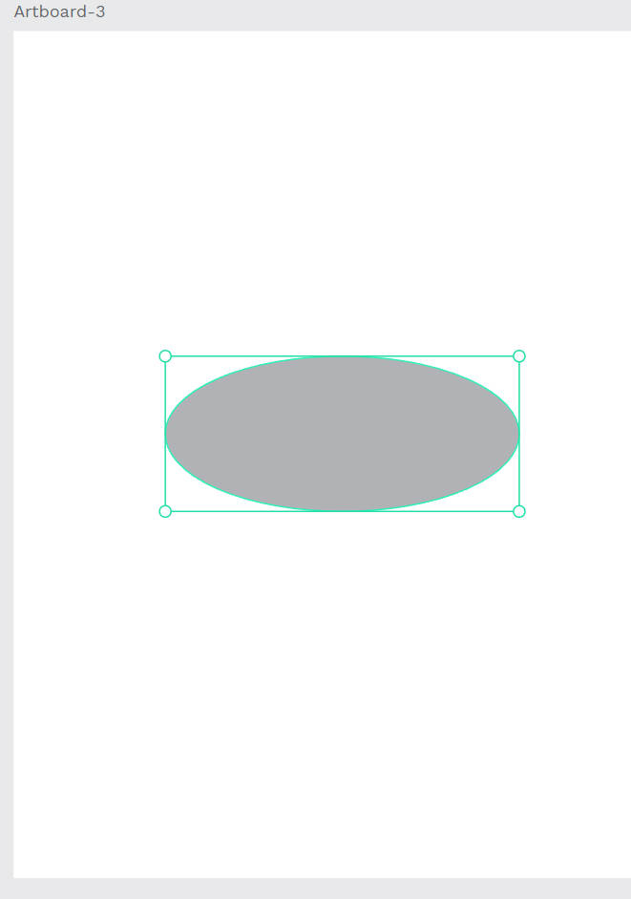
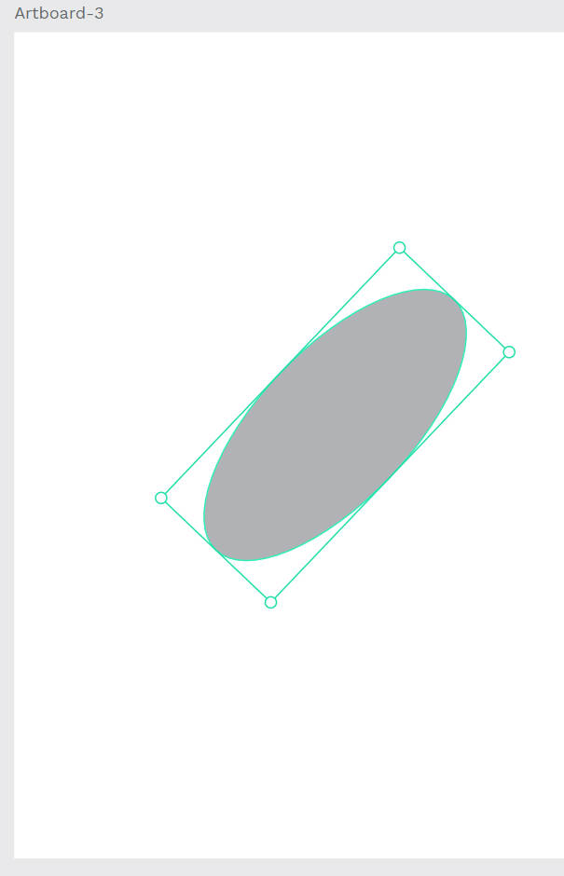
2.4 Penpot Layer Basics (I)
Rotating layers
To rotate selected layers you can use the handlers at the edges of the selection box. Make sure the cursor is in rotation mode. If you hold Ctrl/⌘ while rotation the angle will change in 45 degree increments. You can also find this option at the design panel.
Picture © https://help.penpot.app/user-guide/

Slide 51
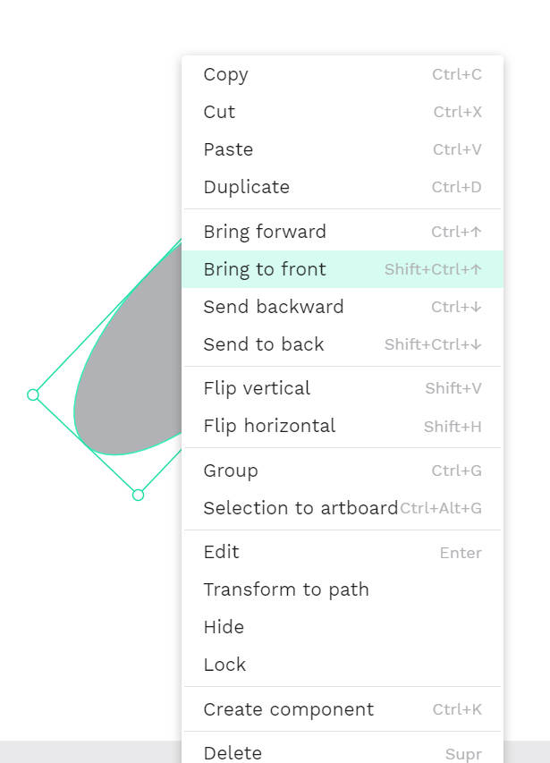


2.4 Penpot Layer Basics (I)
Flipping layers
Right click the mouse.
To flip a layer horizontally press Shift/⇧ + H. To flip a layer vertically press Shift/⇧ + V. You can also find these actions at the layers menu.
Picture © https://help.penpot.app/user-guide/

Slide 52
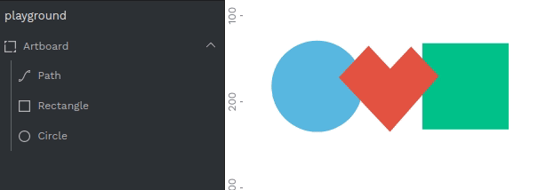
2.4 Penpot Layer Basics (I)
Layers panel
At the layers panel you can see all the layers of a file page. Drag the layers to arrange them to different positions.
Layers are displayed from the bottom to the top of the layer stack, with layers above on the stack being shown on top in the image.
Picture © https://help.penpot.app/user-guide/

Slide 53
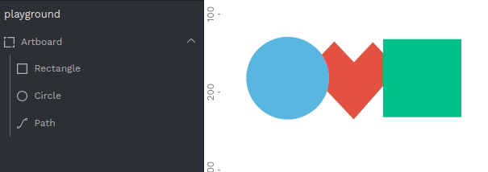
2.4 Penpot Layer Basics (I)
Hide and lock layers
Click on the eye icon to change the visibility of a layer. Click on the lock icon to lock or unlock a layer. A locked layer can not be modified.
Picture © https://help.penpot.app/user-guide/

Slide 54
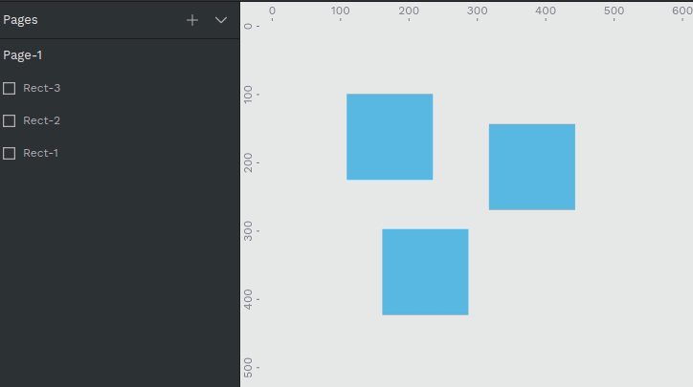
2.4 Penpot Layer Basics (I)
Selecting layers
The simplest way to select a layer is to click on it. Make sure that you have the “move” pointer selected at the toolbar.
To select multiple layers you can click and drag around the layers you want to select. You can also click more than one layer while pressing Shift/⇧. If you hold Shift/⇧ and click you can deselect layers individually.
Picture © https://help.penpot.app/user-guide/

Slide 55
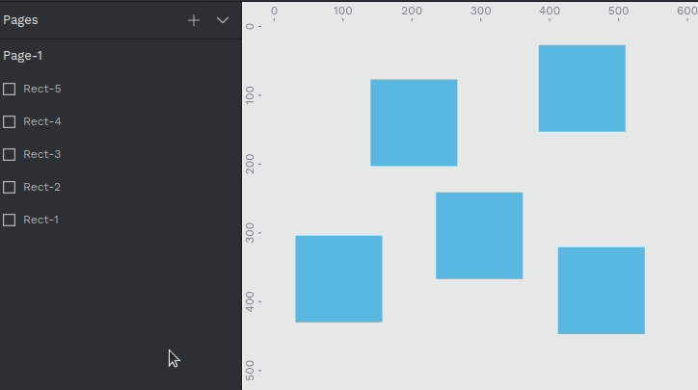
2.4 Penpot Layer Basics (I)
Selecting layers at the layers panel
Click a layer to do a single selection.
Press Ctrl/⌘ while clicking two or more layers to do a multiple selection.
If you press Shift/⇧ while selecting two or more layers all the layers within the selection area will be selected.
Picture © https://help.penpot.app/user-guide/

Slide 56
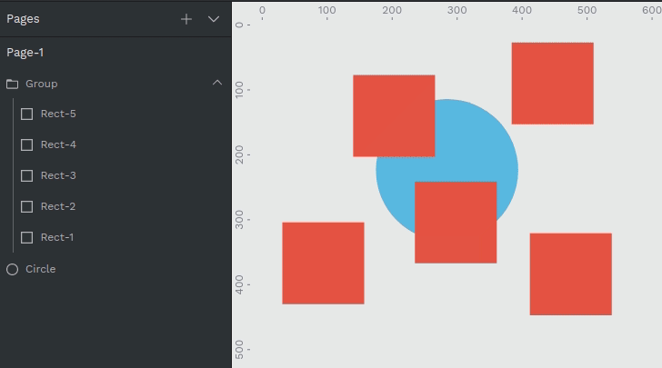
2.4 Penpot Layer Basics (I)
Selecting layers ignoring groups
If you want to select an element that is difficult to reach because is under a group of elements, hold Ctrl/⌘ to make the selection ignore group areas and treat all the objects as being at the same level.
Picture © https://help.penpot.app/user-guide/

Slide 57
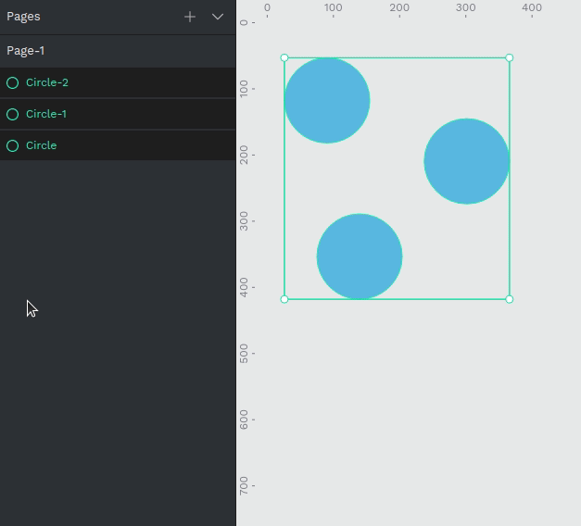
2.4 Penpot Layer Basics (I)
Grouping layers
Grouped layers can be moved, transformed or styled at the same time. To group two or more layers you have to select them and then press Ctrl/⌘ + G. You can also use the option at the layers menu that you can open with right click.
To ungroup press Shift/⇧ + G or use the option at the layers menu that you can open with right click over the group.
To select a layer inside a group you do double click. First click selects the group, second click selects a layer.
Picture © https://help.penpot.app/user-guide/

Slide 58
Penpot Layer Basics (II)
2.5

Slide 59
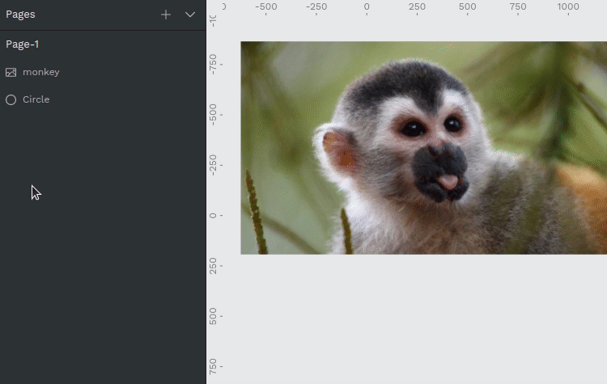
2.5 Penpot Layer Basics (II)
Masking layers
A mask is a layer that does a clipping and only shows parts of a layer or multiple layers that fall within its shape.
To mask layers you first have to select more than one layer or a group of them. Then you can apply the masking using the option at the layers menu or by pressing Ctrl/⌘ + M. The shape that is at the lowest level at the layer list will be used as a mask.
To unmask press Shift/⇧ + Ctrl/⌘ + M or use the option at the layers menu.
Picture © https://help.penpot.app/user-guide/

Slide 60
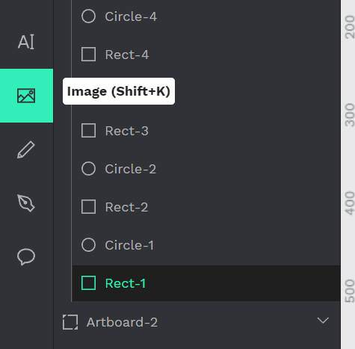
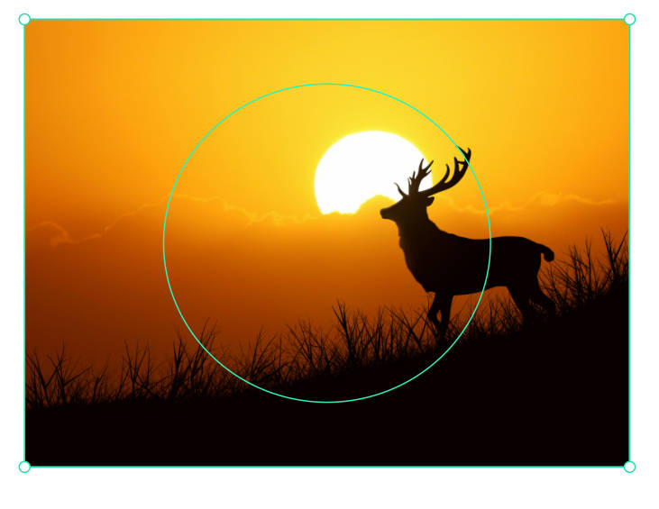
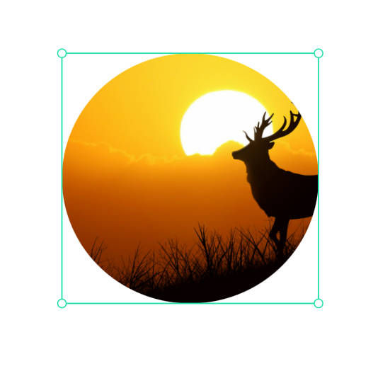
2.5 Penpot Layer Basics (II)
Masking layers
Find the image button in the toolbar, select the image you like to try, and try to use the masking layer.
Picture © https://help.penpot.app/user-guide/

Slide 61
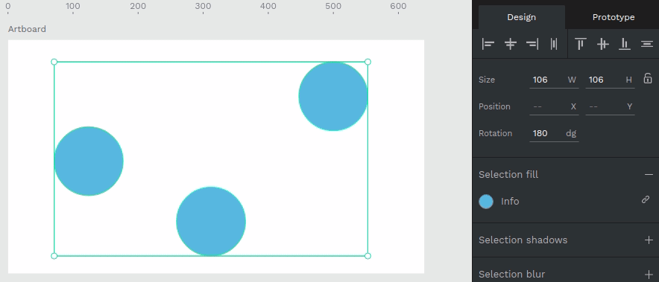
2.5 Penpot Layer Basics (II)
Aligning and distributing layers
Aligning and distributing layers can be found at the top of the Design panel.
Aligning will move all the selected layers layers to a position relative to one of them. For instance aligning top will align the elements with the edge of the top-most element.
Picture © https://help.penpot.app/user-guide/

Slide 62
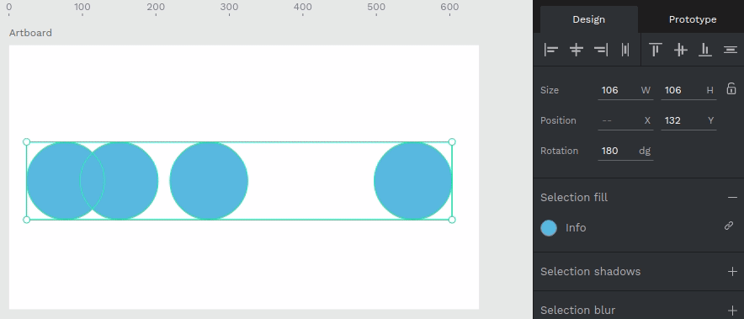
2.5 Penpot Layer Basics (II)
Aligning and distributing layers
Distributing
objects allow you to position them vertically and horizontally with equal distances between them.
Picture © https://help.penpot.app/user-guide/

Slide 63
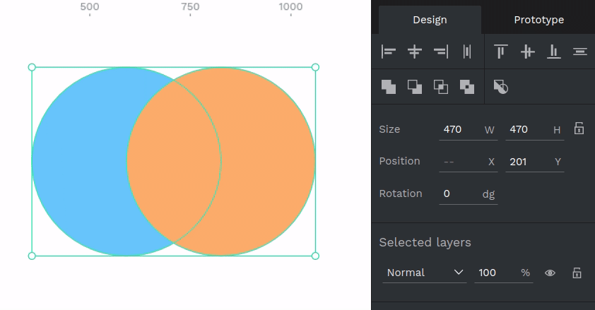
2.5 Penpot Layer Basics (II)
Boolean operators
It is possible to combine shapes in a group in different ways to create more complex objects by using "boolean" operators. Boolean operators are non destructive and the original shapes remain grouped and available or more editing. There are five boolean operations available: Union, difference, intersection, exclusion and flatten. Using boolean operations allows many graphic options and possibilities for your designs.
Picture © https://help.penpot.app/user-guide/

Slide 64


2.5 Penpot Layer Basics (II)
Use the ellipses tools to create four ellipses like the photo, Arrange ellipses from top to bottom and change each color.

Slide 65
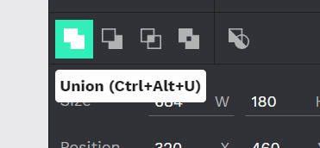
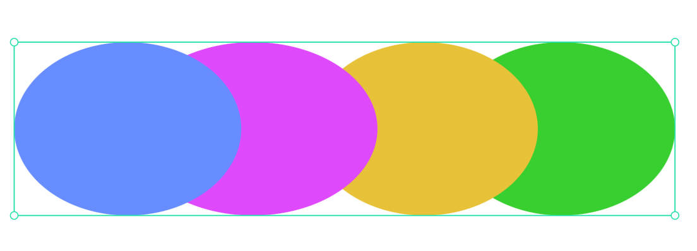
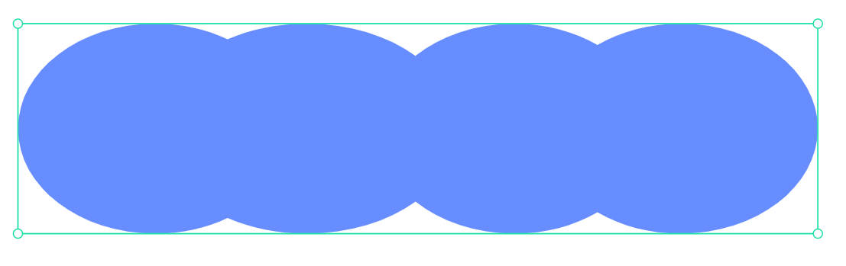
2.5 Penpot Layer Basics (II)
Boolean operators
Union: The resulting combination is the sum of the shapes.
Picture © https://help.penpot.app/user-guide/

Slide 66
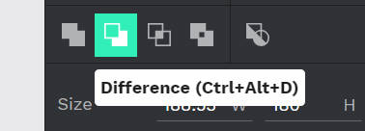

2.5 Penpot Layer Basics (II)
Boolean operators
Difference: the opposite of union, the resulting object has the area of the shape on top has been cut out from the shape at the bottom.
Picture © https://help.penpot.app/user-guide/

Slide 67



2.5 Penpot Layer Basics (II)
Boolean operators
Intersection: creates a group whose shape is the overlapping area between the shapes.
Picture © https://help.penpot.app/user-guide/

Slide 68



2.5 Penpot Layer Basics (II)
Boolean operators
Exclude: the opposite of intersection, the resulting shape is the area that does not overlap between the shapes.
Picture © https://help.penpot.app/user-guide/

Slide 69




2.5 Penpot Layer Basics (II)
Boolean operators
Flatten: Technically not a boolean operator, this is the way to permanently combine the paths of a group of shapes in a single one.
Picture © https://help.penpot.app/user-guide/

Slide 70

2.5 Penpot Layer Basics (II)
Paths (bezier)
A path is composed of two or more nodes and the line segments between them, which may also be curved. To draw a new path you have to select the path tool by clicking on the icon at the toolbar or pressing P. Then you have two ways to create the path:
Click to create a new corner node.
Click and drag to create a curved node.

Slide 71

2.5 Penpot Layer Basics (II)
Paths (bezier)
To finish the path:
Close it clicking over the starting node.
Leave it open pressing Esc or Enter to stop editing. Then press Esc to exit the edit mode.

Slide 72

2.5 Penpot Layer Basics (II)
Paths (bezier)
Edit nodes
To edit a node double click on a path or select and press Enter. You can choose to edit individual nodes or create new ones. Press Esc to exit node edition.

Slide 73

2.5 Penpot Layer Basics (II)
Paths (bezier)
Node types
There are two types of nodes: curve or corner (straight). The type of a selected node can be changed at the bezier menu. Curved nodes have bezier handles that allow the curvature of a path to be modified.To edit a node double click on a path or select and press Enter. You can choose to edit individual nodes or create new ones. Press Esc to exit node edition.

Slide 74
Penpot Logo Practice
2.6

Slide 75

2.6 Penpot Logo Practice
Activity
Apple Logo
Students can follow the teacher's demonstration to make the images in the picture on the right, or they can try to make their own using the skills they have learned.
Picture © https://upload.wikimedia.org/wikipedia/commons/f/fa/Apple_logo_black.svg

Slide 76



2.6 Penpot Logo Practice
Activity
Apple Logo
Step 1: Input the image in the artboard, turn the layer opacity into normal 50%.
Like the right-side picture.

Slide 77



2.6 Penpot Logo Practice
Activity
Apple Logo
Step 2: Create an ellipse, holding shift, make it become a circle, and change the base color. Duplicate the circle and use align vertical center button, to make it the same level.

Slide 78



2.6 Penpot Logo Practice
Activity
Apple Logo
Step 3: Adjust the two circles and fit the original logo size at the same time, press the Union button to make the two circles become a same shape.

Slide 79


2.6 Penpot Logo Practice
Activity
Apple Logo
Step 4: After you have the shape, press the flatten button, to make the shape permanently combine the paths. Is using for us to adjust the paths.

Slide 80




2.6 Penpot Logo Practice
Activity
Apple Logo
Step 5: Select the bottom of the shape, choose the three-point, and pull it down into the bottom of the logo. But is hard to see and adjust the paths, so turn the layer opacity into normal 50% again.

Slide 81


2.6 Penpot Logo Practice
Activity
Apple Logo
Step 6: Adjust the paths to fit the logo size like the right-side photos.

Slide 82


2.6 Penpot Logo Practice
Activity
Apple Logo
Step 7: Now we have the apple shape, time to make the leaf shape, create the ellipse on the leaf and turn to same color of the apple shape.

Slide 83



2.6 Penpot Logo Practice
Activity
Apple Logo
Step 8: adjust the ellipse fit into the leaf size, and turn the layer opacity into normal 50%.

Slide 84




2.6 Penpot Logo Practice
Activity
Apple Logo
Step 9: Continue to adjust the ellipse, right-click the ellipse two times open the path Options, like the right side photo. press the to coner button, to make the ellipse become a diamond shape, and choose the path button, give the four edge four points like the photo.

Slide 85

2.6 Penpot Logo Practice
Activity
Apple Logo
Step 10: Slowly adjust the shape to become a leaf shape.

Slide 86



2.6 Penpot Logo Practice
Activity
Apple Logo
Step 11: Now with the basic shape of the shape, the position of the remaining gap, create a circle, and place and align the position according to the position of the gap. Press the Difference button and get the full apple logo we create.

Slide 87

2.6 Penpot Logo Practice
Activity
Apple Logo
Step 12: Turn back the layer opacity into normal 100% and go into the view mode, check out what the logo renders look like. If the logo has some issue, go back to edit mode to edit it.

